Slide 1
MOBILE APPLICATION PROGRAMMING
PRESENTATION OF AN IDEA FOR
CS-GY 9033
Presented by:
VIJETH NARENDRA PAI
N14193983; vijeth.pai@nyu.edu

Slide 2

Currently NYU Classes does not have a Mobile Application program.
All the students need to access NYU classes to keep themselves updated with class schedules, assignments, deadlines, calendar events etc.
Inconvenient to turn on laptop or get hold of a desktop, to check NYU classes website.
Mobile website is very shabby and inefficient

Slide 3
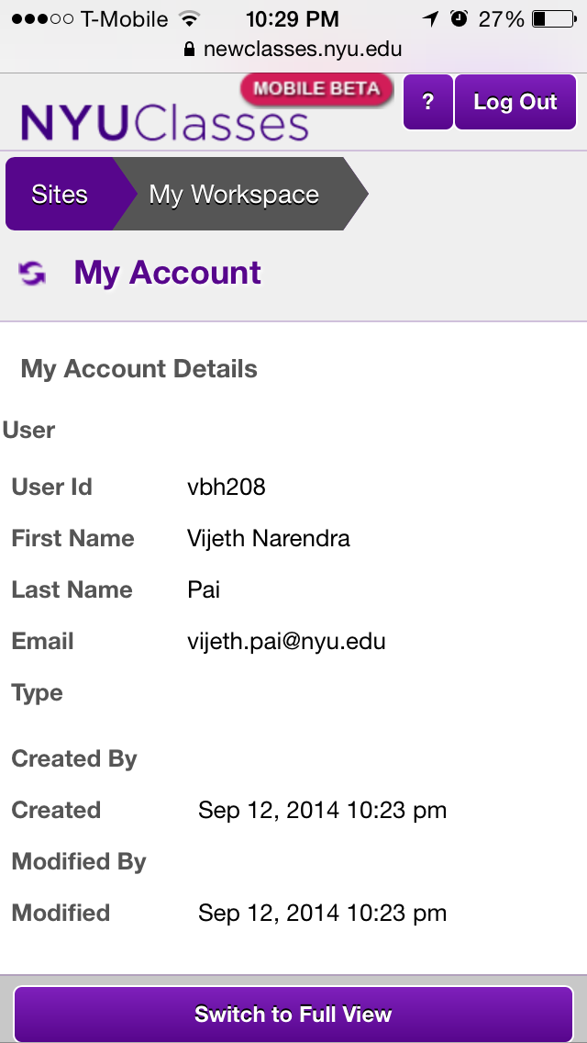
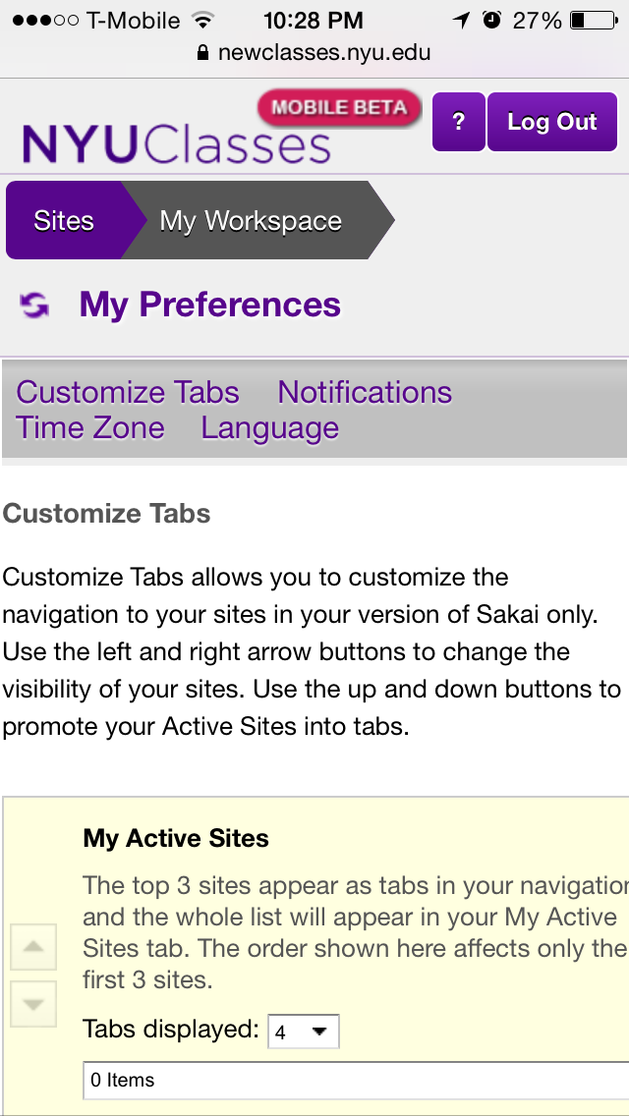
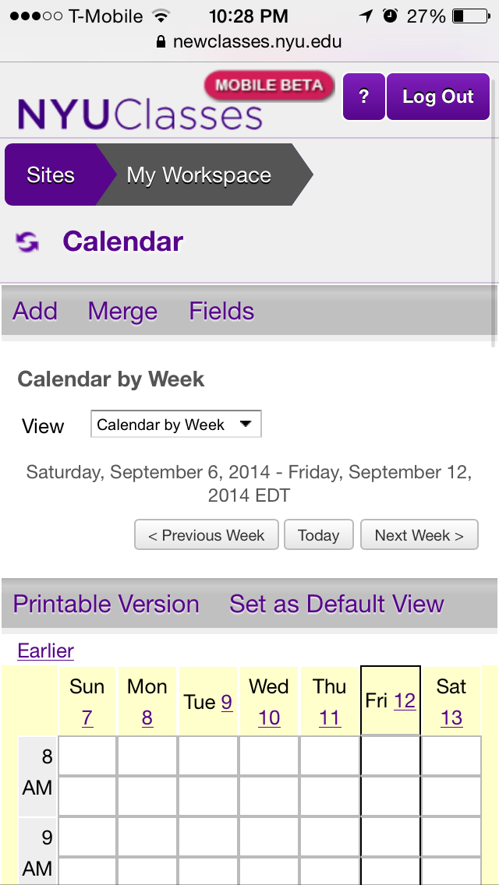
Sample images of how the App would look when functional

Slide 4
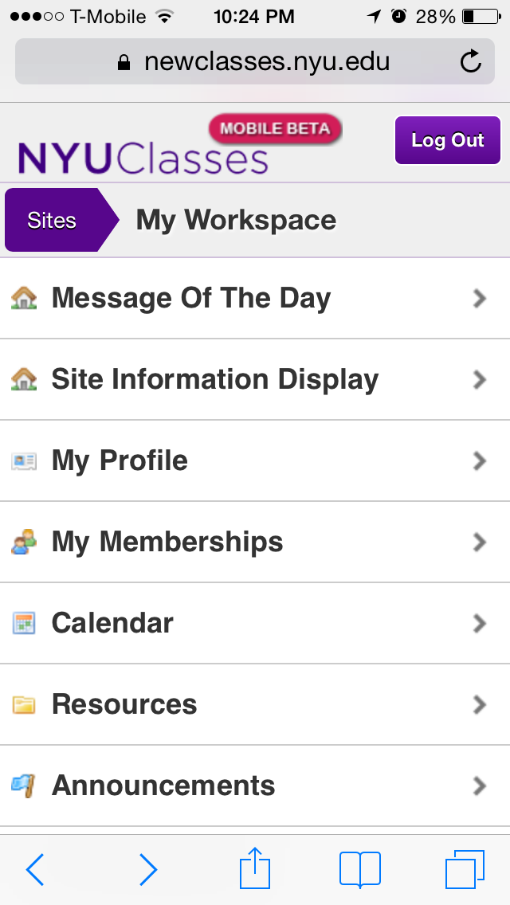
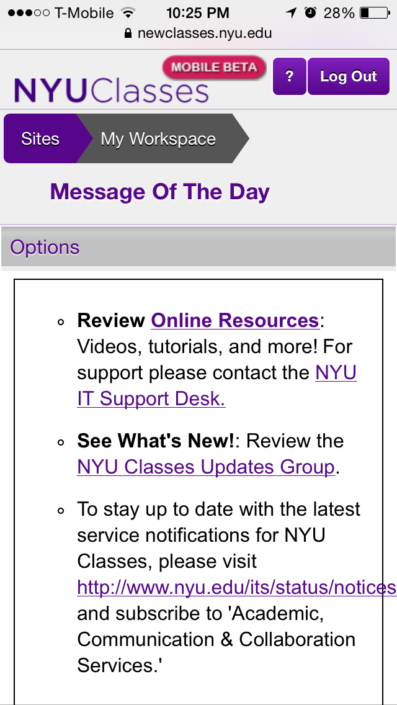
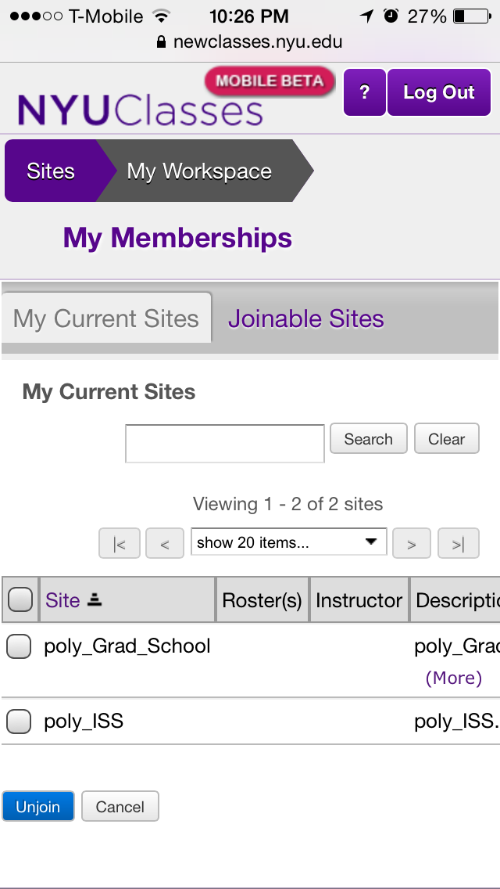
Sample images of how the App would look when functional.

Slide 5
Idea derived from Blackboard App.
Very functional app.
Charged $2 for 1 year subscription.

Slide 6
THANK YOU

